Slide 1
Administration Assistant
JG3 (SP5-6)
Job Information Pack
July 2026

Slide 2
St Peter’s C of E Primary School
In our last SIAMS inspection it was noted that:
“There is a passionate team commitment, which enables all pupils to make ‘marvellous mistakes’ that build character, perseverance and excellence in the choices they make. Consequently, behaviour is of the highest standard. Relationships are close and harmonious.”
In February 2023, Ofsted said:
‘Pupils thrive at this highly inclusive and welcoming school. They fully understand what it means to be a ‘St Peter’s Citizen’. Pupils say that this helps them feel part of a community where everyone gives their best and sets a positive example to others.’
‘Relationships between staff are warm and respectful. Staff, including those who are new to teaching, are proud to work at the school and value its team spirit. They appreciate how leaders consider their workload and support their development.’
I hope you will enjoy learning more about what it is like to be a part of our very special school community and warmly invite you to visit the school to find out more about life at St Peter’s.
Catrin Battista
Welcome from our Executive Headteacher
On behalf of the children, staff, and governors, I welcome you to St Peter’s Church of England Primary School in Portishead.
We are a welcoming, inclusive family school with a strong Christian ethos, a sense of community and a commitment to excellence for all children in our care.
We think of excellence in three different ways:
Excellence in who we are - we aim to ensure that all our children are becoming people who are kind, generous and respectful individuals.
Excellence in all we do - we aim to ensure that each of our children becomes an enthusiastic, resilient learner.
Excellence in our service with others - we aim to help all our children to become people who want to work to make the world a better place.
We are extremely proud of our school and the achievements of all of our children.

Slide 3
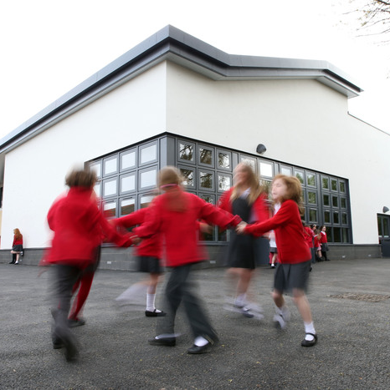
Our Location
St Peter’s Primary School can be found in the beautiful and vibrant town of Portishead – just a 20 minute drive from the centre of Bristol.
Our school is set in extensive grounds with large fields, play areas and a conservation area. We are fortunate to have modern and well resourced classrooms in which to teach and learn.
Our site includes:
21 classrooms
Large shared learning spaces in Foundation Stage & Years 1 to 3
Spacious staffroom facilities
3 halls
Library and music rooms
CPD training room for staff development
Large outdoor play spaces with two fields
Conservation area with woodland and outdoor classroom

Slide 4

Working at St Peter’s
What We Can Offer You:
A warm, welcoming and highly supportive team who are passionate about working together and making a difference every day.
A thriving school community with high aspirations, where excellence, kindness and ambition are at the heart of everything we do.
Wonderful children who are happy, respectful, enthusiastic and eager to learn, making every day rewarding.
A dedicated and collaborative administrative team, where colleagues support one another and play a vital role in the success of the whole school.
A strong partnership with our families, who value the school and work alongside us to achieve the very best for every child.
A leadership team that genuinely prioritises staff wellbeing, placing workload and work-life balance at the centre of decision-making.
An inclusive Church of England school, where everyone is welcomed, diversity is celebrated, and every individual is valued and encouraged to flourish.
The opportunity to be at the heart of a busy, vibrant primary school, where no two days are the same and your contribution will have a real impact on children, families and the wider school community.

Slide 5
The Role of an Administrative Assistant
As a member of our administrative team, you will play a pivotal role at the heart of our school, ensuring that every day runs smoothly and that every child, family, visitor and member of staff receives a warm and professional welcome – whether in person or on the phone.
This is a varied, fast-paced and rewarding role and you will work within a friendly and experienced team. From managing daily attendance to supporting school events, trips and communications, to maintaining vital pupil and staff records, coordinating recruitment processes and working closely with our leadership team, you will be instrumental in the life of our school.
If you are highly organised, enjoy building positive relationships, thrive on variety and take pride in making a real difference behind the scenes, this is an exciting opportunity to become part of a dedicated team committed to providing the very best experience for our children and community.

Slide 6

Administrative Assistant: Hours and Salary
Hours:
20 hours a week
8.30 – 12.30 daily
Term-time only (+ 5 Inset Days)
Contract: Fixed Term until August 31st 2027 – pending a review of the administrative structure
Salary: JG3 SCP 5 – 6 Annual FTE: £25,583 - £25,989
Actual Salary £12,762.06 - £12,878.21

Slide 7
Application Information
Visits to the school are warmly encouraged. Please email enquiries@sppschool.uk or call the team at our welcome desk, on 01275 843142 to book in for a visit. Please be aware that the last day of term is Wednesday 22nd July so you will need to visit before this date.
Please also be aware that early applications are encouraged. The school reserves the right to interview and appoint prior to the closing date of the advertisement, should the school be able to identify an appropriate candidate.
The deadline for all applications is Wednesday 5th August at 9am and interviews will take place on Tuesday 11th August.
All applications are online via : https://ce0218li.webitrent.com/ce0218li_webrecruitment/wrd/run/ETREC179GF.open?WVID=970751RHa8&VACANCY_ID=9800831InP
Safeguarding Statement:
Lighthouse Schools Partnership supports Equal Opportunities Employment. The Trust is committed to safeguarding and promoting the welfare of children and young people and expects all staff to share this commitment. Enhanced DBS checks are required for all successful applicants.

